Slide 1
EDA and Predictive Analysis of IPL data
Portfolio Project # 02

Slide 2



TEAM MEMBERS
Muhammad Taha
Cohort 3 Student
Muhammad Zaeem
Cohort 3 Student
Muhammad Ali
Cohort 3 Student

Slide 3
Torture the data, and it will confess to anything.
~Ronald Coase

Slide 4
Introduction
Let’s start with the introduction of dataset

Slide 5
IPL
Indian Premier League (IPL) is a famous league in India
Ipl is T20 cricket format league
The league was founded by Board of Control for Cricket India (BCCI) in 2008

Slide 6
DATASET
Data till season 11 (2008 - 2019)
It contains two tables
    Matches (Match by match data)
    Deliveries (Ball by ball data)

Slide 7
DATASET COLUMNS
Matches.csv
Match_id is the primary key in this table. Mostly used columns are toss_winner, venue and winner.
Deliveries.csv
This table has one to many relationship with matches.csv. One observation represents one ball. It contains total_runs, batsman and bowler columns.

Slide 8
ROADMAP
Selecting Bowler
Toss Decision
Strategy
1
3
5
2
4
6
Selecting Batsman
Playing Eleven
Prediction

Slide 9
Bowler Selection

Slide 10
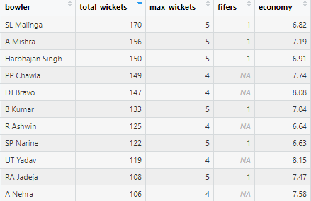
Bowler Statistics

Slide 11
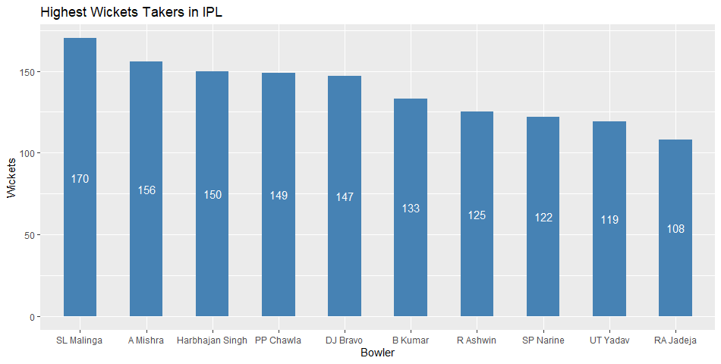

Slide 12
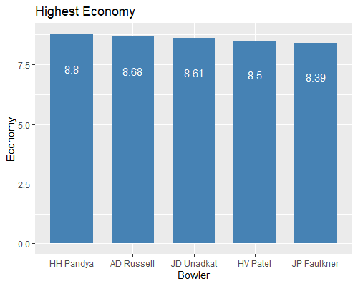
Economy = Total Runs / Total Overs bowled by the bowler
Bowler that takes more wickets and have low economy will be selected for the team !

Slide 13
Batsman Selection

Slide 14
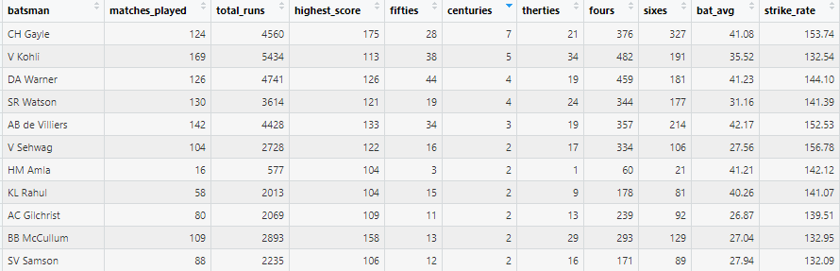
Batsman Statistics

Slide 15
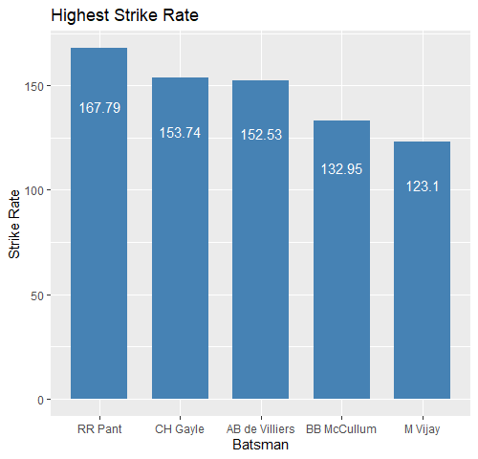
Top 5 Batsman highest Strike Rate

Slide 16
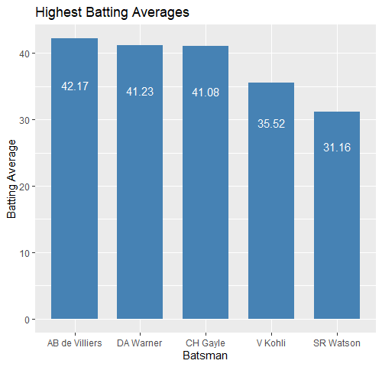

Slide 17
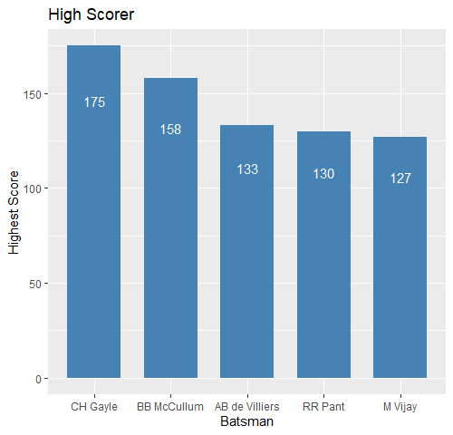

Slide 18
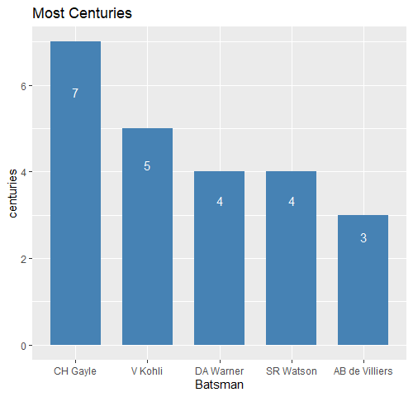
Batsman will be decided based on the best results which we described earlier.

Slide 19
Playing 11

Slide 20
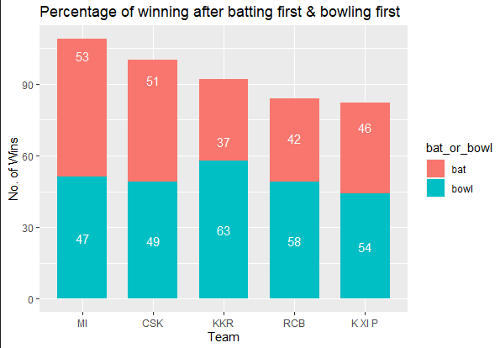
MATCH WINNING PROBABILITY ON PARTICULAR GROUND CHOOSING BATTING

Slide 21
DOES A BATSMAN DO GOOD OR BAD AT GROUNDS
Player | Ground | Average | Strike Rate
Virat Kohli | IS Bindra Stadium | 68 | 125.92
Virat Kohli | Eden Gardens | 34.11 | 98.04
Virat Kohli | Feroz Shah Kotla | 50 | 138.54

Slide 22
DOES A BOWLER DO GOOD OR BAD ON A GROUNDS
Player | Stadium | Economy | Average Wicket Per Inning
Rashid Khan | M. Chinnaswamy Stadium | 11.28 | 1
Rashid Khan | Green Park | 8.5 | 3
Rashid Khan | Wankhede Stadium | 5.01 | 1

Slide 23
CHOOSING BATSMAN AGAINST A TEAM
Batsman | Bowling_Team | Average_of_Player
CA Lynn | Gujarat Lions | 93
HM Amla | Gujarat Lions | 84
CH Morris | Gujarat Lions | 82

Slide 24
Strategy

Slide 25
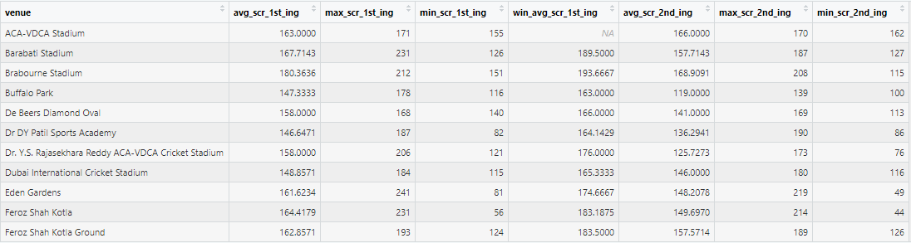
Average Winning Score at a Particular Ground

Slide 26
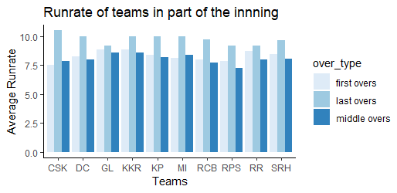

Slide 27
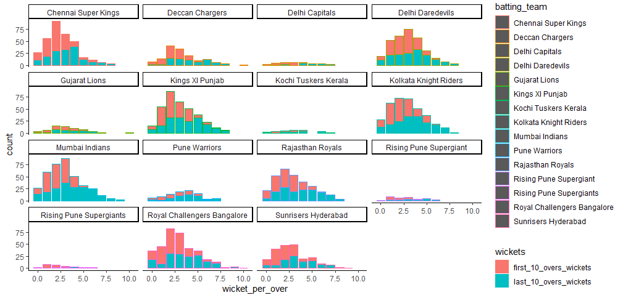

Slide 28
Prediction

Slide 29
Linear Regression

Slide 30
WHAT IS LINEAR REGRESSION?
This is done to gain the information about one through knowing values of others
It is used to Forecast values of dependent variable from the values of independent variables
Use Case: We have predicted the score of a team using this method

Slide 31
PREDICT SCORE OF TEAM BATTING FIRST
In this model we predicted the score of a team batting first.
Independent Variables : Opponent, Toss, Ground, Team
R-Square (10.9%) : It is used to evaluate the precision of the model.
Based on this, we can say it is not a reliable model.

Slide 32
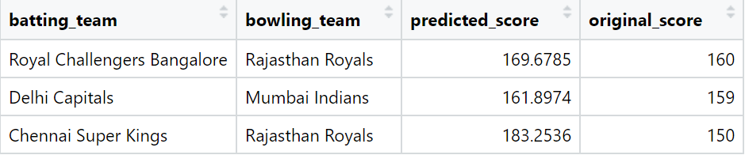
PREDICT SCORE OF TEAM BATTING FIRST

Slide 33
PREDICT SCORE OF TEAM BATTING SECOND
In this model we predicted the score of a team batting second.
Independent Variables : Opponent, Toss, Ground, Team, first_inning_total
R-Square : 47.37%
It is a pretty good model having high R-square.

Slide 34
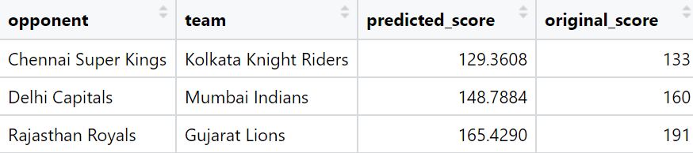
PREDICT SCORE OF TEAM BATTING SECOND

Slide 35
Logistic Regression

Slide 36
WHAT IS LOGISTIC REGRESSION?
Logistic regression is also used to estimate the relationship between a dependent variable and one or more categorical independent variables
Whenever the outcome of dependant variable is discrete like 0,1 or Yes,No we use logistic regression
Use Case: We have predicted whether a team will win or lose base on the score of the team that is batting first

Slide 37

How Logistic Regression Work?
Wins
207, 197, 178, 189
Model
Lose
158, 118, 126

Slide 38
LOGISTIC REGRESSION MODEL
Splitting Data
Model Selection
Confusion Matrix & Accuracy
1
3
5
2
4
6
Applying model to training Data
Testing Model with testing data
Critical Value
& Prediction

Slide 39

CONFUSION MATRIX
Accuracy = (56 + 36) / (56 + 27 + 31 + 36) = 0.69

Slide 40
PREDICTING RESULTS OF A MATCH
SCORE | PROBABILITY | RESULTS
200 | 0.72 | W
180 | 0.57 | W
150 | 0.38 | L
130 | 0.21 | L
Note: This model has the ability to predict right results with 69 percent accuracy.

Slide 41
THANKS!
Any questions?

